Slide 1

CSYE 7200
For League of Legends
Team 6: Lei Liu 001443309
Xuanshan Xiao 001474067

Slide 2
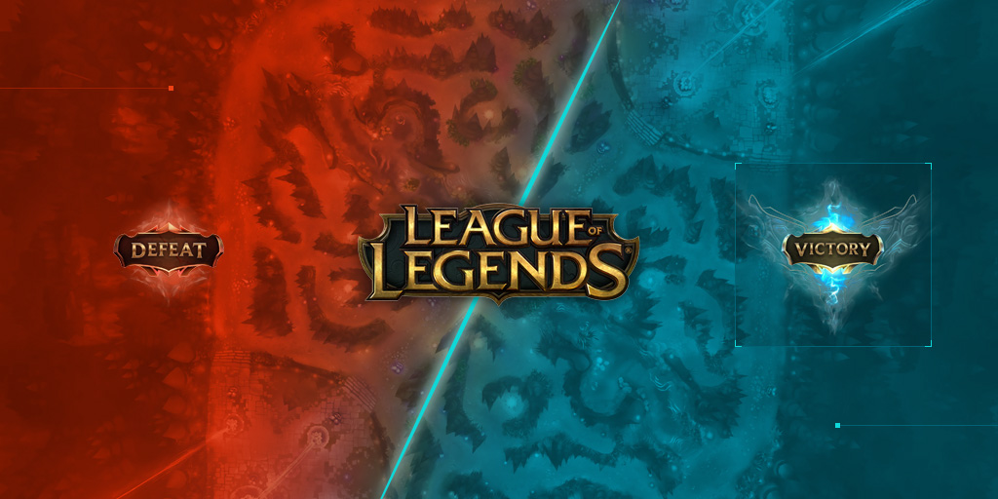
Background
A 5 VS. 5 moba game with two sides, blue and purple
Each team has 5 positions [top,mid,jungle,bottom,support]
3. Each summoner has to pick a champion
4. The order of picking should be : blue picking 1 -> purple 2 -> blue 2 -> purple 2 -> blue 2 -> purple 1

Slide 3
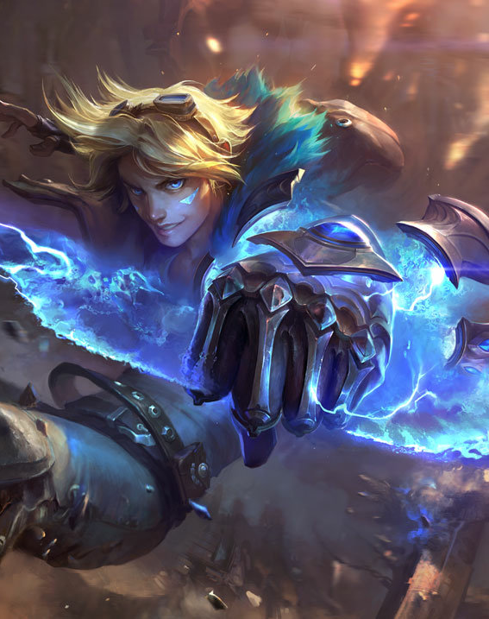
Introduction
A system of recommending a champion for summoner in rank, according to the champions already picked and the summoner’s proficiency of the champions.

Slide 4

Use Case
One summoner -> search rank records -> return the latest rank records
One summoner -> search champions -> return a champion list ordered by proficiency
One summoner -> input champions picked by both sides -> return a champion list ordered by the winrate and grouped by the positions
One summoner -> input the champions of each team -> return the prediction of the winrate of the team

Slide 5
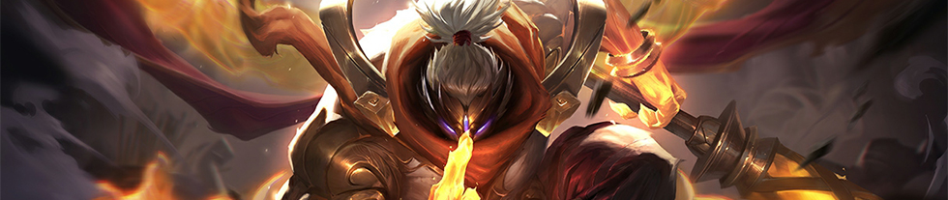
Methodology
Crawling players’ data and rank records
Divide the rank data into two parts : Train and Test
Build a model and train the model
Test the model

Slide 6
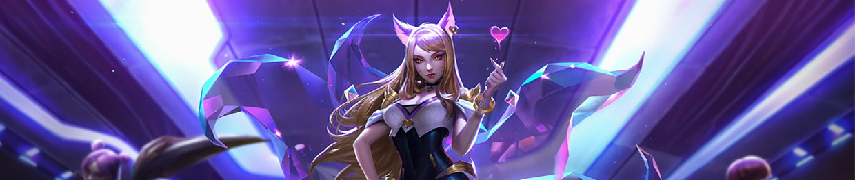
Data Source
Crawling user data from https://na.op.gg
Live match data fetched from Riot.(20 calls a second)
At least 50000

Slide 7

Milestones
Week1 :
Build repo and scala project structure(1h)
Crawler for collecting the user data and the match data(8h)
Cleanse Data(10h)
Store the data(2h)
User data API(2h)

Slide 8
Milestones Cont.
Week 2:
Calculate the win rate (12h)
Matchup winrate(9h)
Winrate(4h)
Build the model for recommending champions(16h)
Week 3:
Champion recommendation API(5h)
Unit test(8h)
Deploy project on aws(8h)

Slide 9

Techniques
Version Control - Github
Programming language
Scala - connect each part, main language
MLib - build a model
Spark - collect data
Zeppelin - data visualization, data analysis and presentation
Platform
AWS
Make API calls to collect data
Reposons to user’s API call

Slide 10

Criteria
Users getting one user case responses in 2 seconds
Model updating time through Spark and Zeppelin within 20 min
Accuracy of predication on winning rate of the winner higher than 60%

Slide 11

Goals
Give recommendations on user-specific champion selection.
Deploy a platform that automates the whole workflow.

Slide 12
THANK YOU
CSYE 7200

